Slide 1
Make friends with your customers
incust.com
80% of income comes from
20% loyal customers

Slide 2
How many cards do you carry in your wallet?
Customer Friendship System
Customers either:
Collect discount cards, and often all cards do not fit into the wallet;
Do not fill out questionnaires and do not carry plastic cards.
But every visitor wants:
To be recognized and served as a loyal customer (even when they have forgotten the card at home or have no place in their wallets);
Personalized communication, attention, friendship.

Slide 3
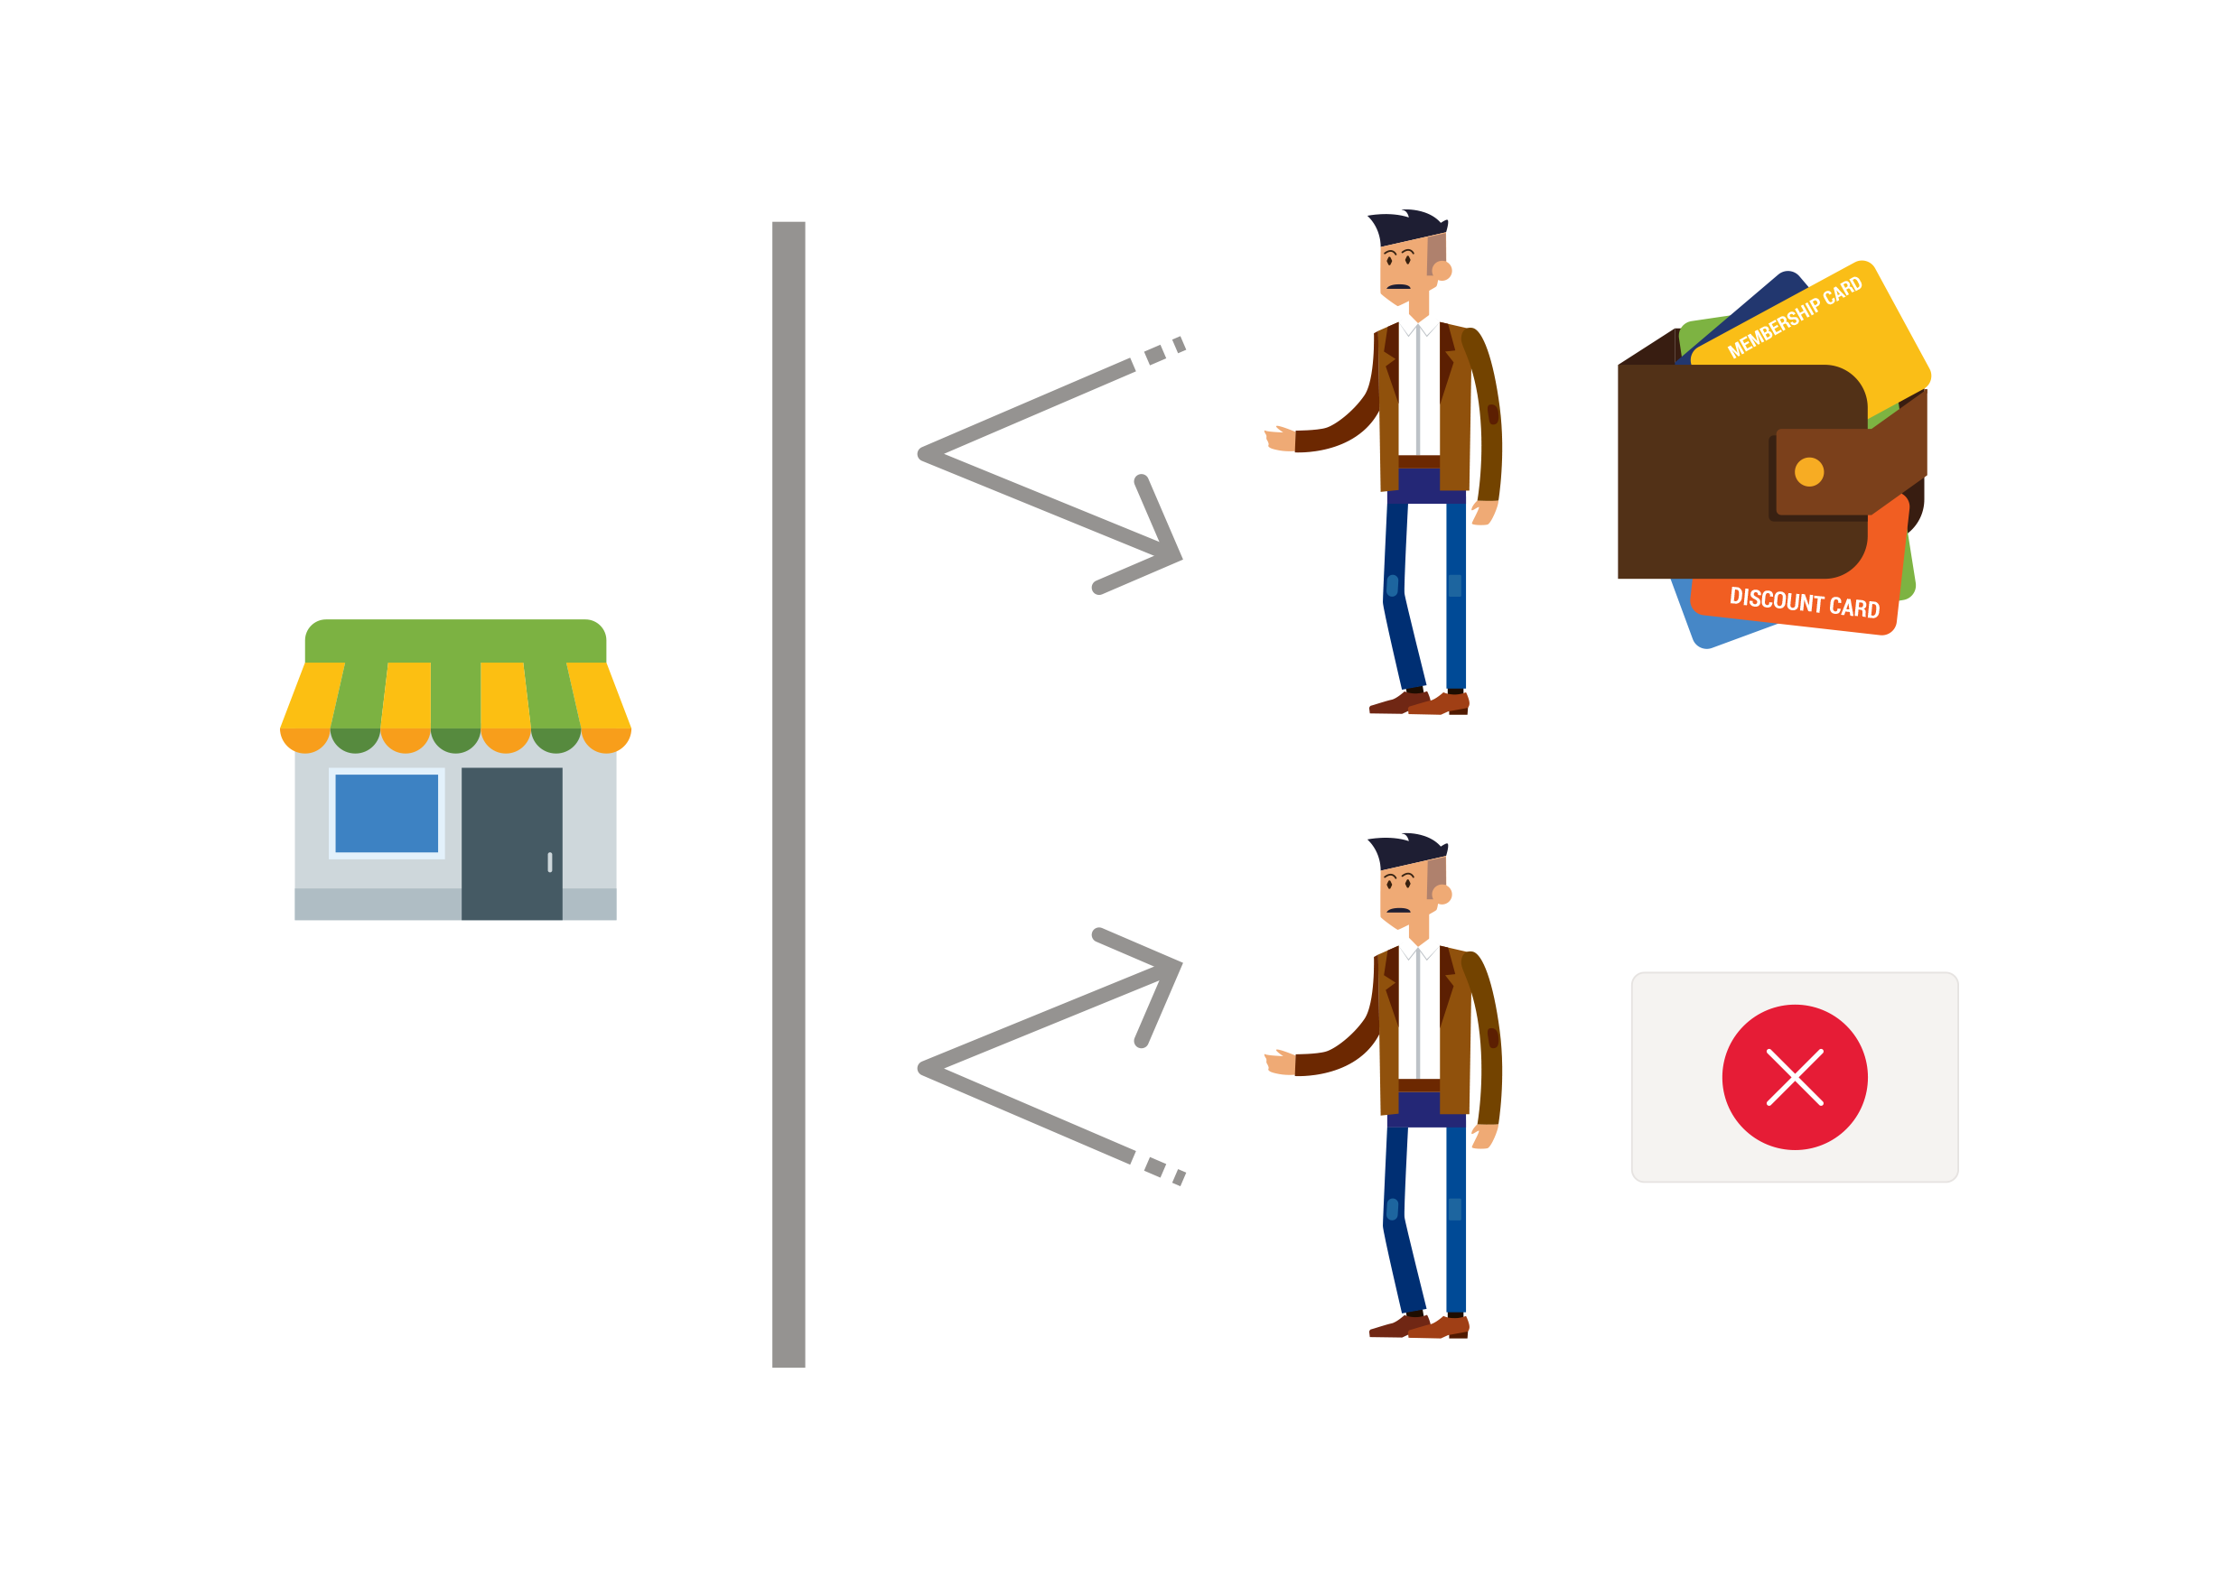
Customer Friendship System

Slide 4
How to build relationships with a customer?
Customer Friendship System
How to establish friendship with the customer?
How to collect and segment your customer base?
How to conveniently communicate with the customer?
How to save on discounts?
How to attract new customers?
How to attract customer’s friends?

Slide 5
Customer Friendship System

Slide 6
inCust method:
Customer Friendship System
Without plastic cards
Without spending on equipment and software
Without time expenses

Slide 7
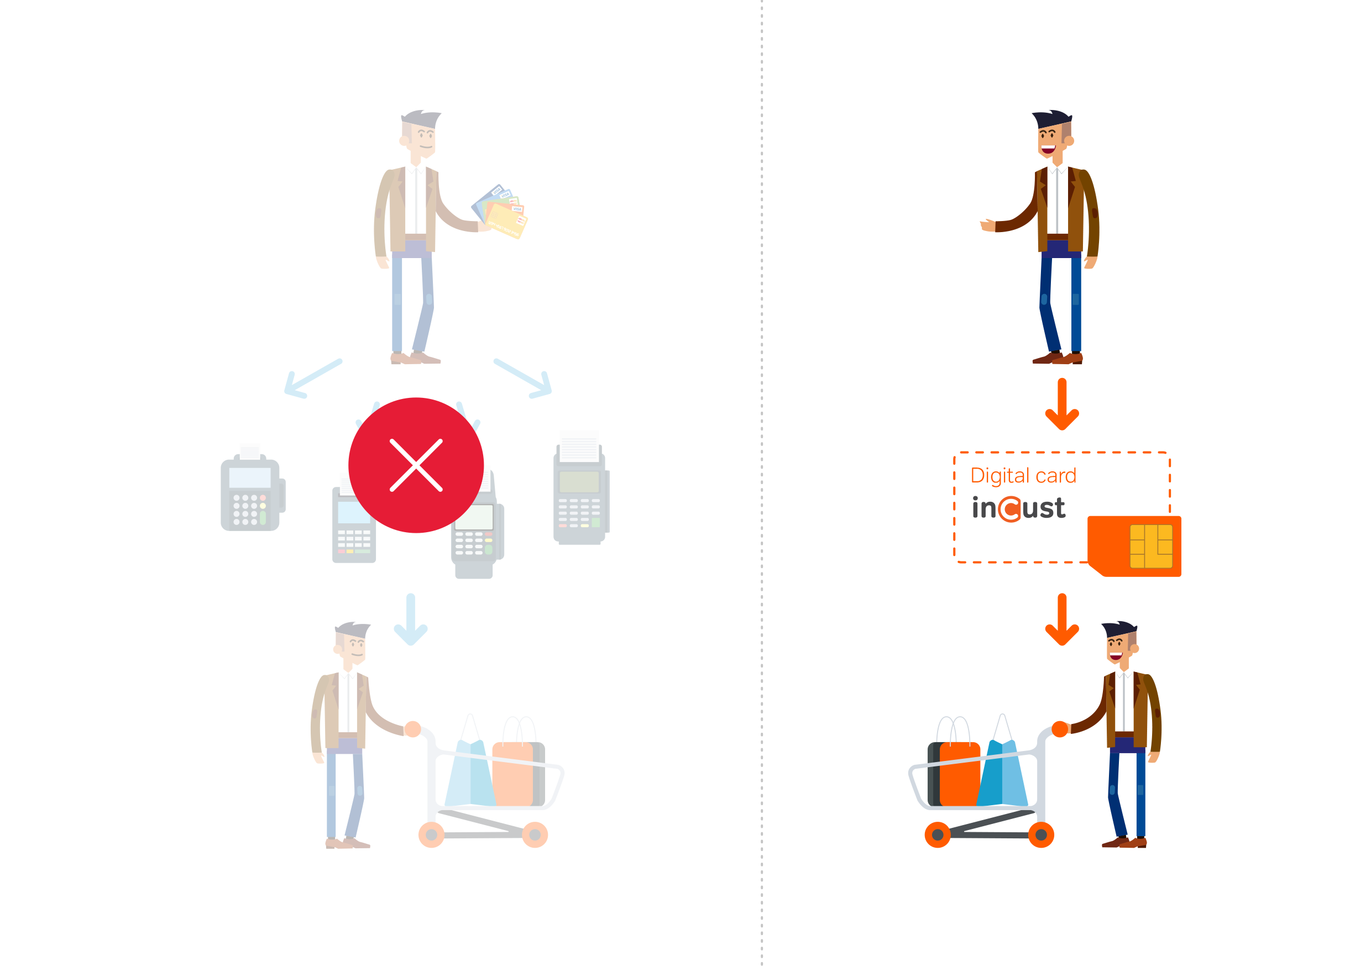
Customer Friendship System

Slide 8
inCust secret sauce ingredient 1/3
Customer Friendship System
Phone number is a customer’s e-card
Instant connection of new customers to the loyalty program
Quick building of the contact database
Direct communication with each customer

Slide 9
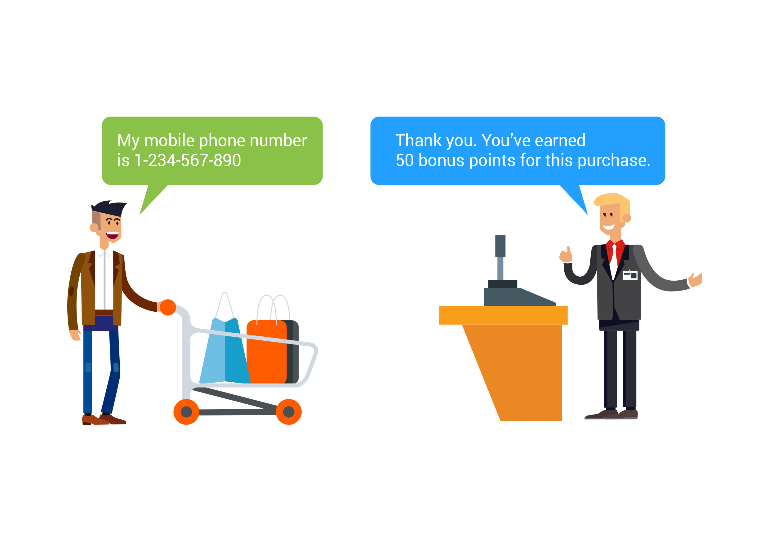
Customer Friendship System

Slide 10
inCust secret sauce ingredient 2/3
Customer Friendship System
One card - many loyalty programs
Convenient communication of the customer with different businesses
One customer's account, but separated bonus points, discounts, coupons
Each business gets its dedicated “section” in customer’s account
Dedicated business portal in the mobile app
Possibility of driving new customers
The place of communication between customers and businesses

Slide 11
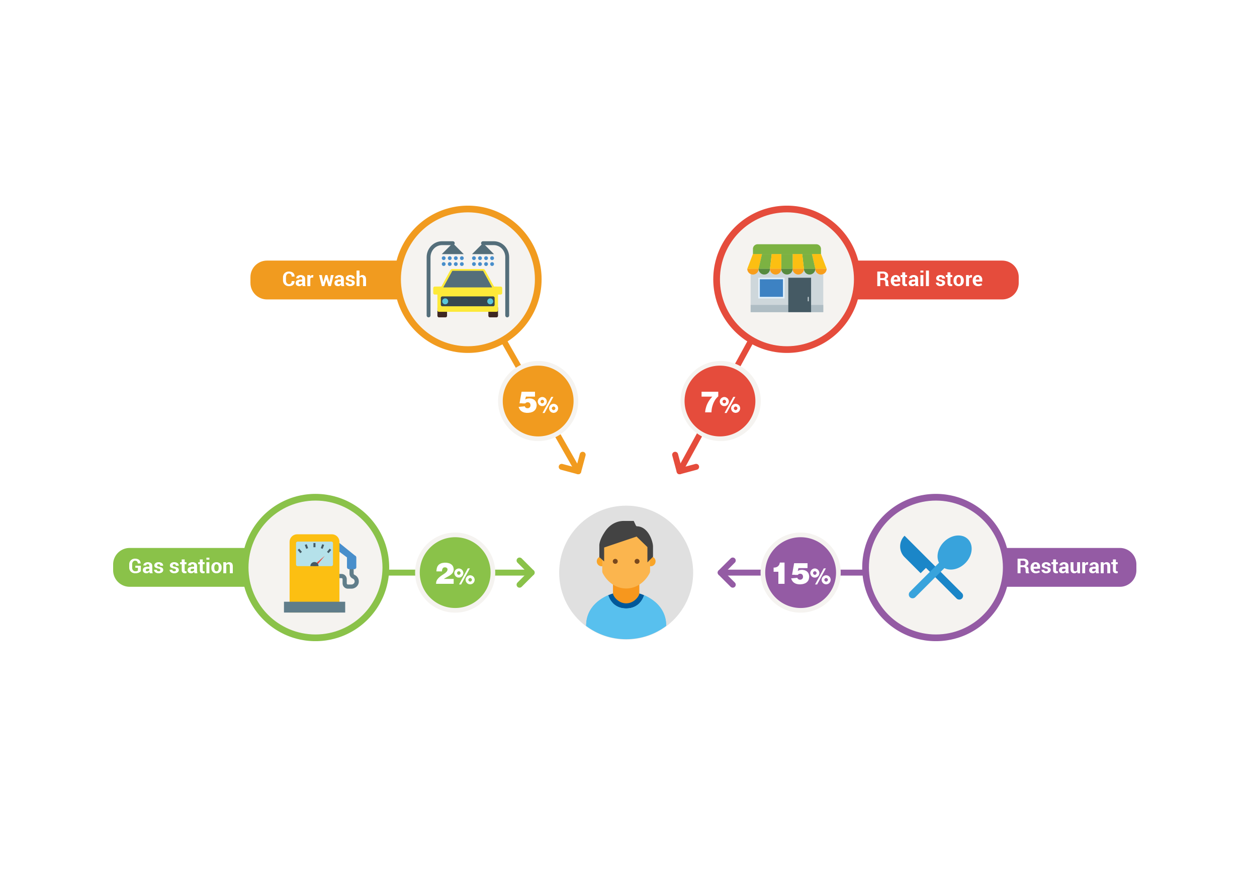
Customer Friendship System

Slide 12
inCust secret sauce ingredient 3/3
Customer Friendship System
Quick start without expenses
Setup and launch within 15 minutes
Free registration and evaluation
Pay only for processing
Works even on a salesperson’s smartphone!

Slide 13
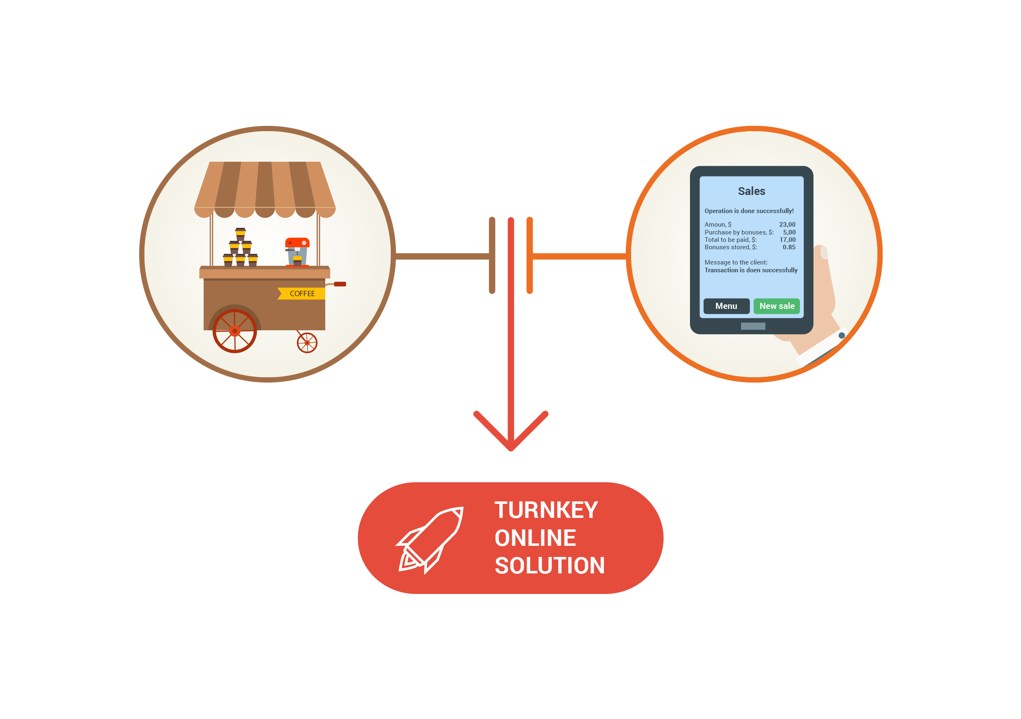
Customer Friendship System

Slide 14
The benefits of using inCust
Customer Friendship System
Efficiently and automatically process purchases
After one-time customization, automatically credits customers’ accounts with benefits (no salesperson participation needed)
Decrease advertising costs
Direct messages work better
Bonus points minimize direct loss on discounts
Increase income
Subscriptions improve cash flow
Loyal customer = frequent customer
Frequent customer = 80% of income

Slide 15
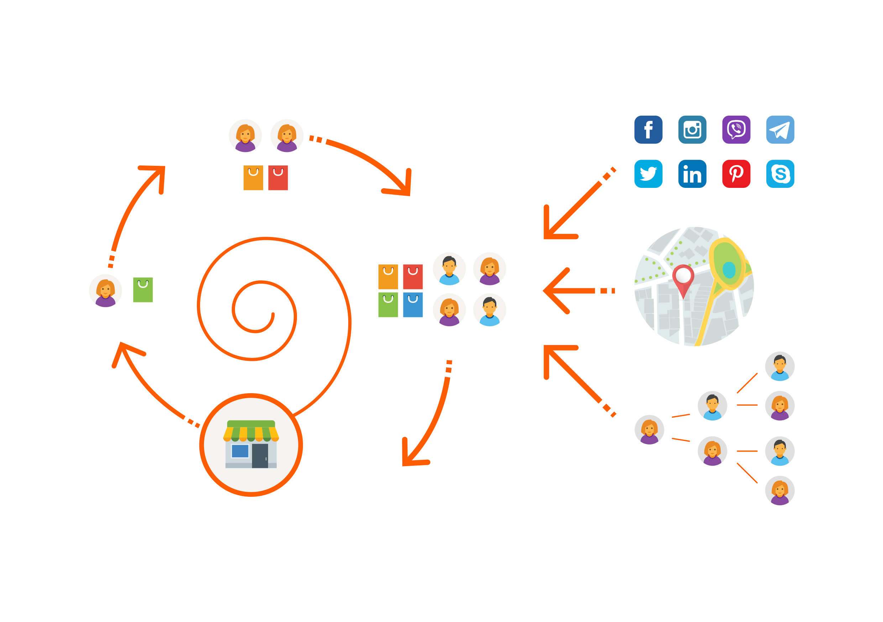
Customer Friendship System

Slide 16
Select only the components which that need
Customer Friendship System
Cloud processing
Salesperson tools
Customer’s app for smartphone
Smartwatch app
SMS, PUSH, Viber and other communications
Analytics and predictive sales
White Label
Integration with the accounting system or POS
Customer identification tools

Slide 17
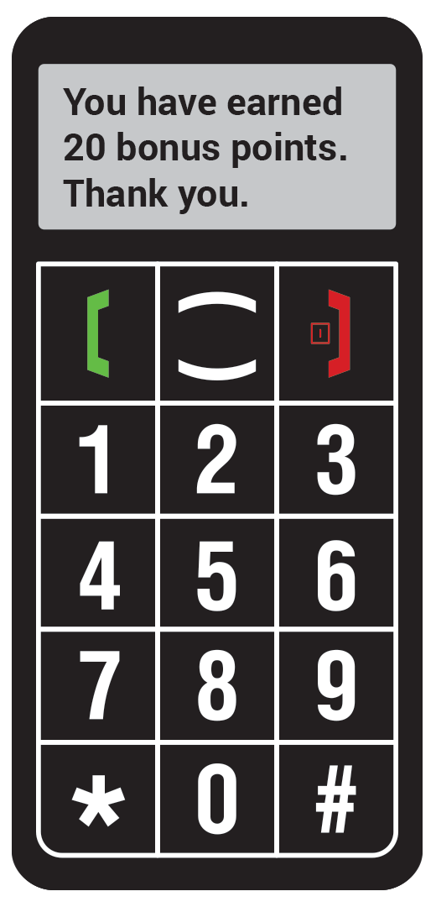
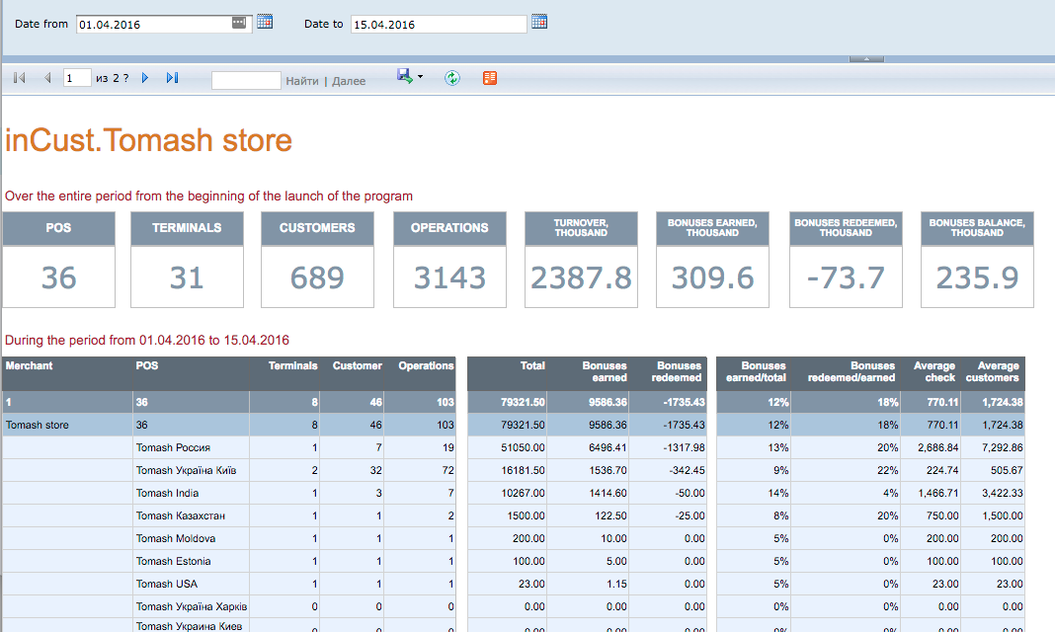
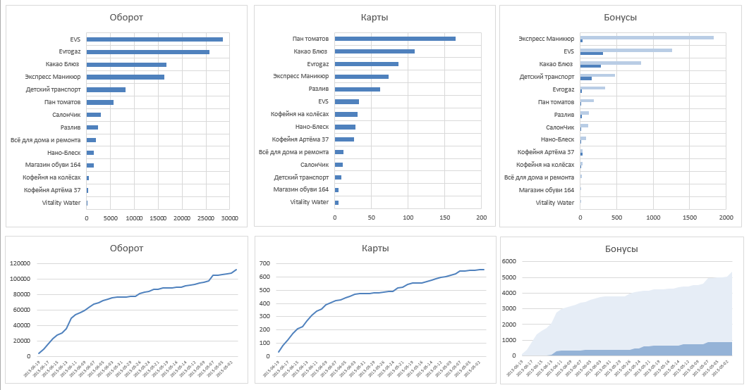
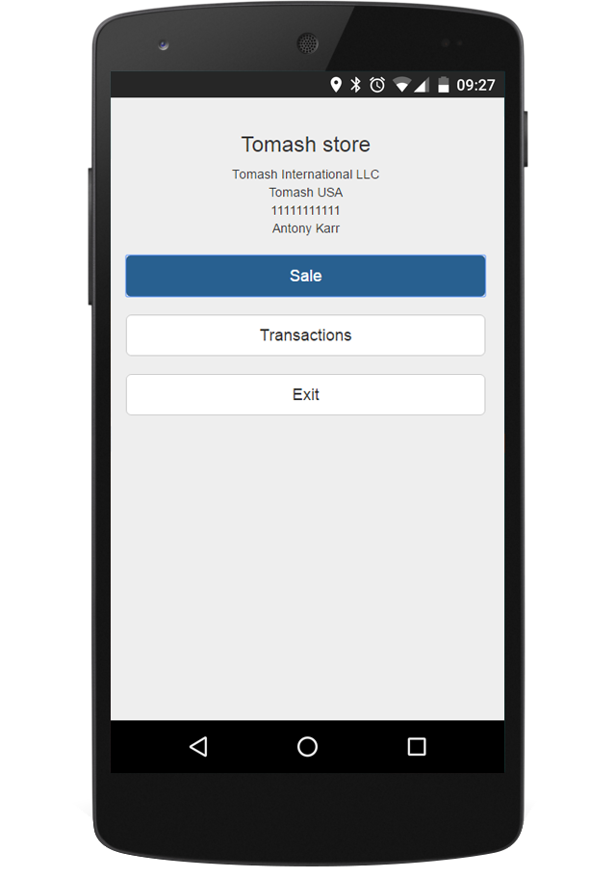
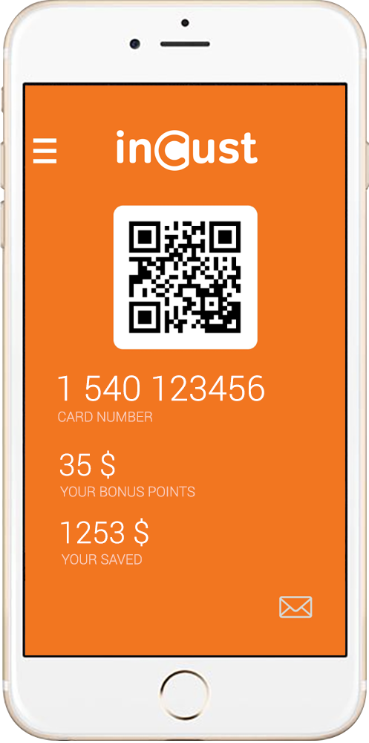
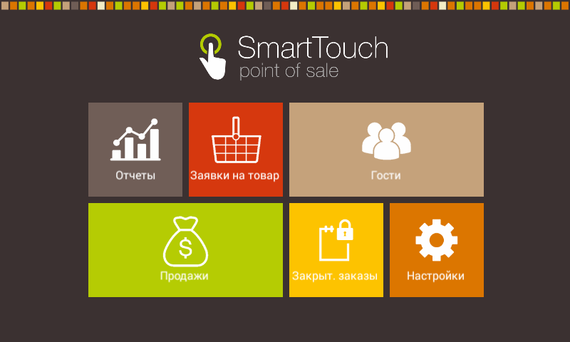
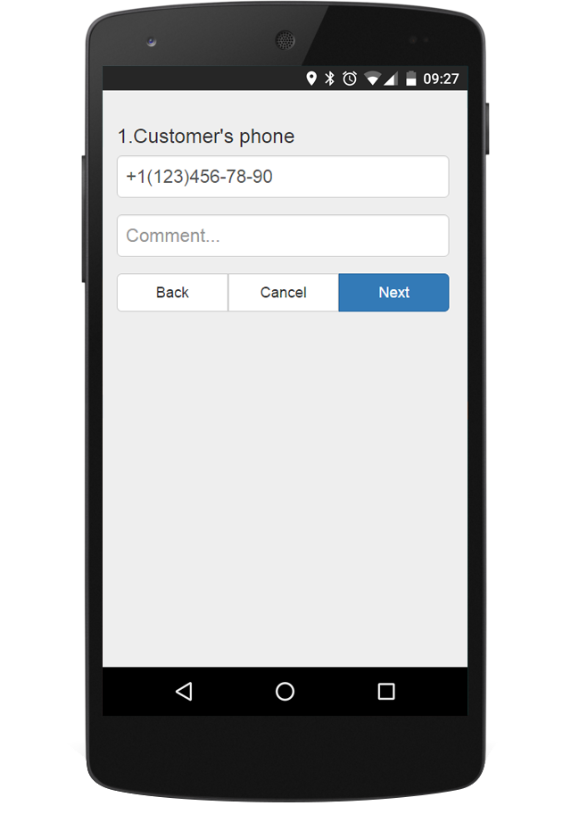
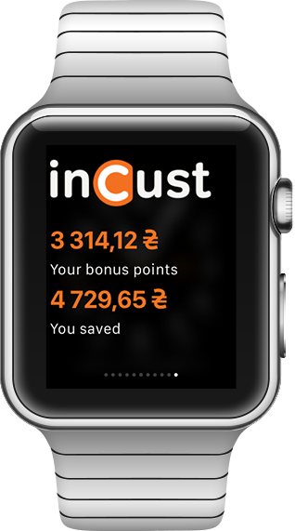
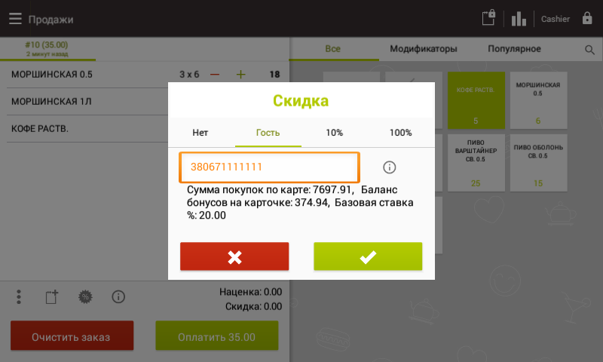
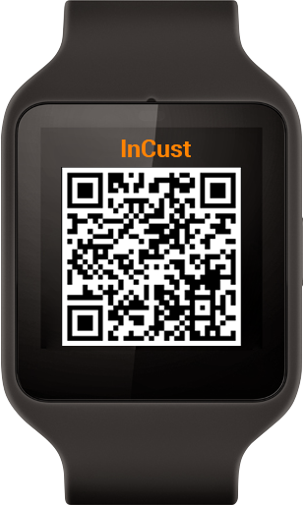
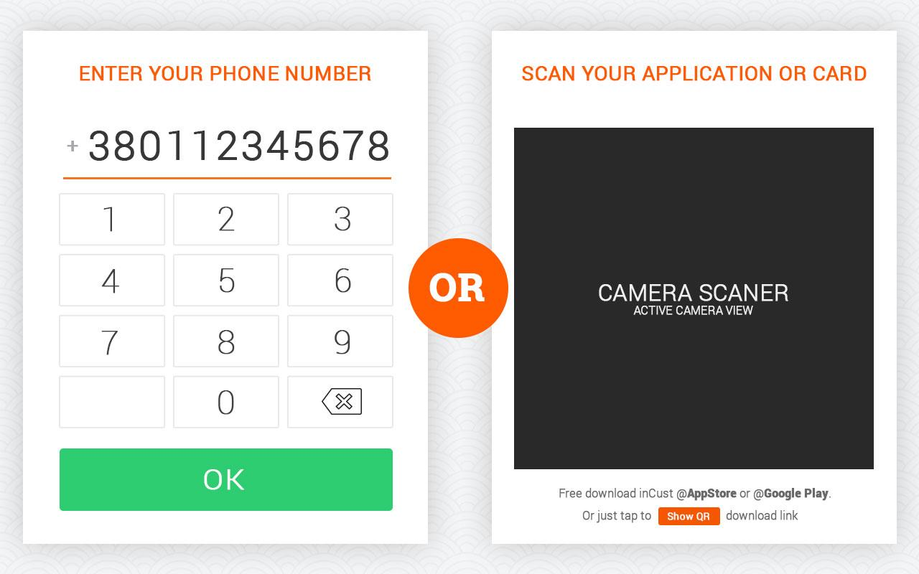
Components of the solution
Customer Friendship System
SALESPOINT APPS
TEXT
MESSAGES
CUSTOMER APPS
REPORTING, ADMIN TOOLS
SAAS
CLOUD
INTEGRATION
WITH POS
SOFTWARE
CARDLESS LOYALTY PROGRAM

Slide 18
Choose methods of interaction with the customer
Customer Friendship System
Customer at the cash desk
Customer in the Internet
On the street
Customer self-identification
Check scanning
By the vending machine
IBeacons and Geo-Targeting
Payment by electronic money
Coalitions and cross-marketing

Slide 19
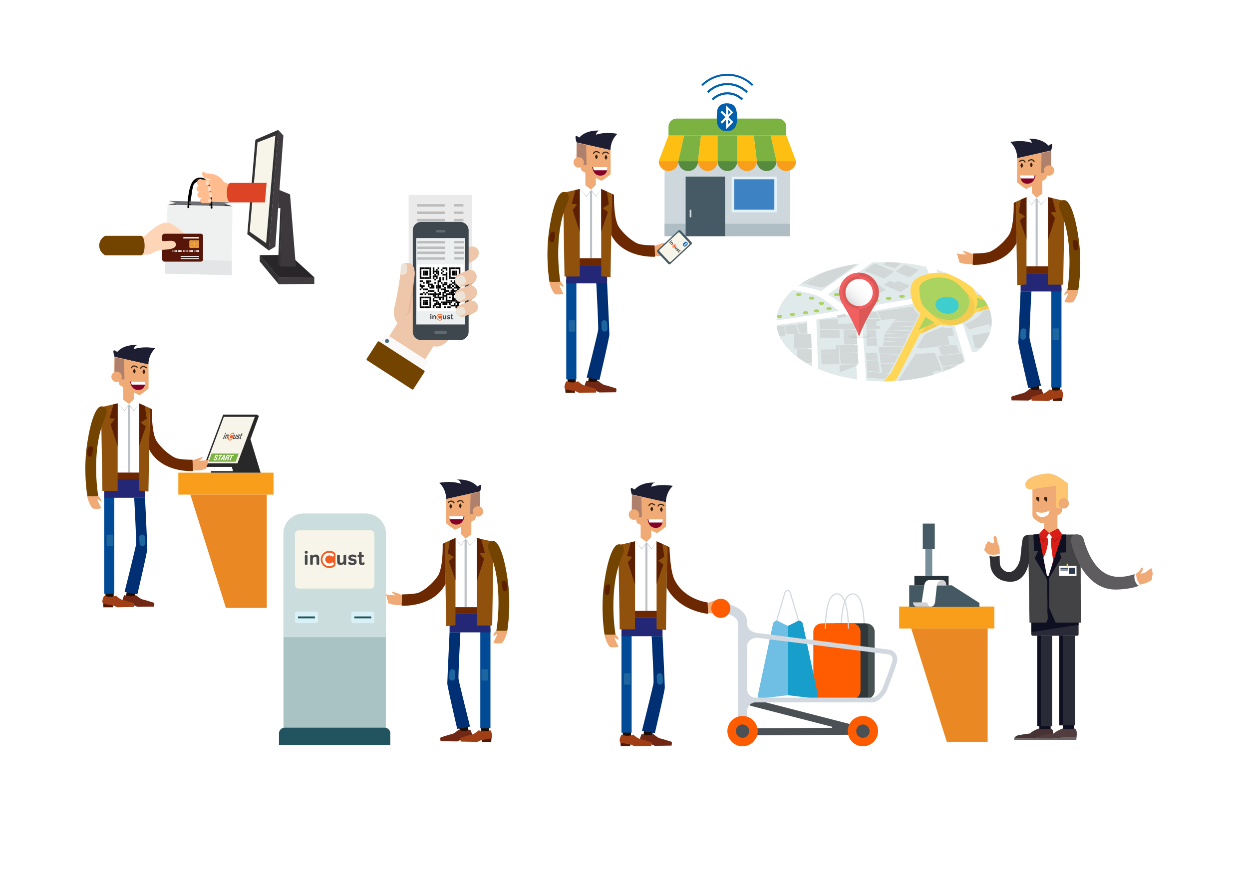
Customer Friendship System

Slide 20
Platform for custom projects
Customer Friendship System
Tourist maps
Loyalty program for shopping malls
Coalition programs
Games
Social projects
Payment platform
Mutual settlement platform
Fuel card
Social and benefit cards

Slide 21
Customer Friendship System

Slide 22
First of all - friendship with the customer
The system of friendship with customersCustomer Friendship System
Communicate with the customer
With a group or individually
Let the customer communicate with you
Make individual offers
Direct marketing
Personal offers
Turn communication with the customer into a game
Anticipate the customer’s wishes

Slide 23
The system of friendship with customersCustomer Friendship System

Slide 24
incust.com
Start making friends with your customers
Sign up now!
Maxim Ronshin
blaze@incust.com
Skype: maximronshin,
MobileMobile, Viber, WhatsAppApp:
+380505067999
+1 804 404 9539, +48223078756
+7 499 404-0234 +38 044 3949594

Slide 25
Loyalty Pays!

